Slide 1
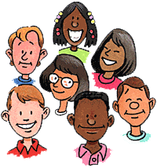
What are Pronouns?
She
I
He
Us
We
We

Slide 2
What are pronouns?
Pronouns take the place of nouns. The word or phrase replaced by a pronoun is called an antecedent.

Slide 3
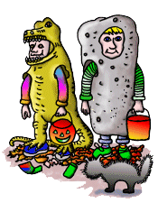
Example:
Halloween is one of America's holidays. It is celebrated in October.
(Halloween is a noun. It is a pronoun that refers to the antecedent, Halloween.)

Slide 4
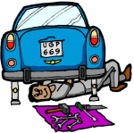
Example:
When Robert was fixing the car, he cut his hand.
(Robert is a noun. He is a pronoun that refers to the antecedent, Robert.)

Slide 5
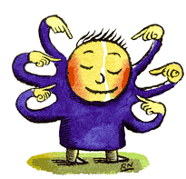
Personal Pronouns
Refer to people or things
Include: I, me, my, mine, you, your, yours, he, him, his, she, her, hers, it, its, they, them, their, theirs, we, us, our, ours.
ME!

Slide 6
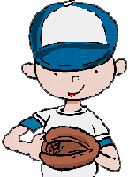
Examples:
He took her place in the game.
Their main objective is to scare students.

Slide 7
Now you try. Which of the following contains a correct pronoun?
A hill is next to them. It is very steep.
Jeff rides his new bike. Him rides it down the block.
Rickie gets on the plane. They are very excited about his trip.

Slide 8
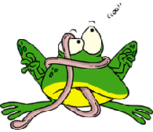
Missed it! Try Again
Think about what or who the pronoun represents.

Slide 9
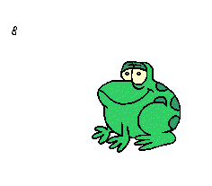
Got it! Now try another.
A hill is next to them. It is very steep.
A hill= It

Slide 10
Choose the correct pronoun.
Skateboards are fun, but
can be dangerous.
A. them
B. it
C. they
D. we

Slide 11
Missed it! Try Again
Think about what or who the pronoun represents.

Slide 12
Got it! Now try another.
Skateboards are fun, but
they can be dangerous
Skateboards = they

Slide 13
Choose the correct pronoun.
Speed bumps help to slow down cars. are found in many parking lots.
A. It
B. You
C. Them
D. They

Slide 14
Missed it! Try Again
Think about what or who the pronoun represents.

Slide 15
Got it! Now try another.
Speed bumps help to slow down cars. They are found in many parking lots.
bumps = They

Slide 16
Choose the correct pronoun.
Marisa and Nora made their own costumes.
wanted to save money.
A. Them
B. We
C. They
D. She

Slide 17
Missed it! Try Again
Think about what or who the pronoun represents.

Slide 18
Got it! Now try another.
Marisa and Nora made their own costumes.
They wanted to save money. Marisa and Nora = They

Slide 19
Which of the following contains a correct pronoun?
A. A hill is next to them. They are very steep.
B. Jeff rides his new bike. Him rides it down the block.
C. Rickie gets on the plane. He is very excited about his trip.

Slide 20
Missed it! Try Again
Think about what or who the pronoun represents.

Slide 21
Got it! Now try another.
Rickie gets on the plane. He is very excited about his trip.
Rickie = He

Slide 22
Which of the following contains a correct pronoun?
A. Blake skated to the edge of the rink. He was finished with practice.
B. The house has two stories. She was built in 1910.
C. Mary and Dave rode their bikes to the playground. Them will build a sandcastle.

Slide 23
Missed it! Try Again
Think about what or who the pronoun represents.

Slide 24
Got it!
Blake skated to the edge of the rink. He was finished with practice.
Blake = He

Slide 25
Ready for a test?
Try the online Pronoun Practice Test by clicking the button below.

